Slide 1
Yuppie City Simulator Use Cases
Nick Montaquila
Michael Nishida
Andrew Ricci

Slide 2
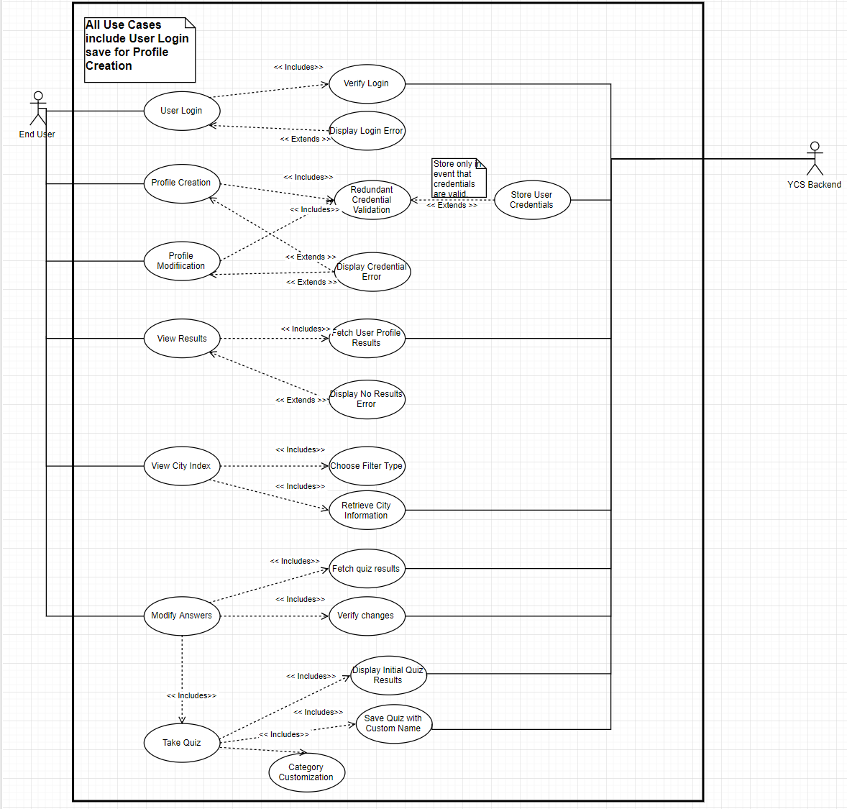
Full Diagram

Slide 3
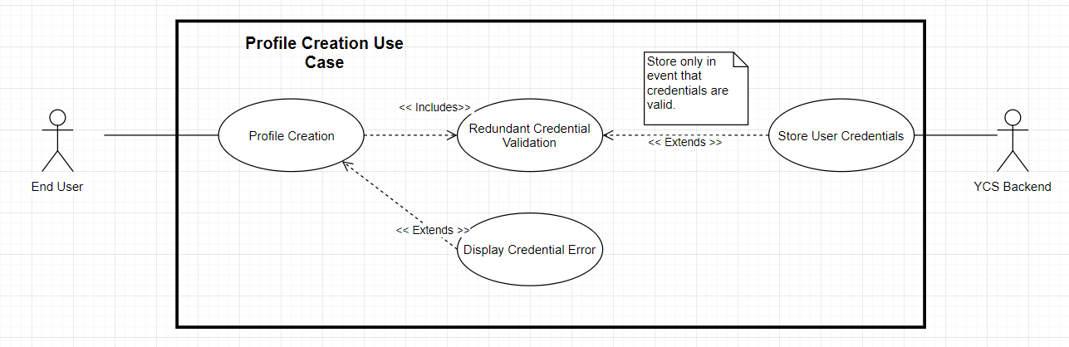
Create User Profile

Slide 4
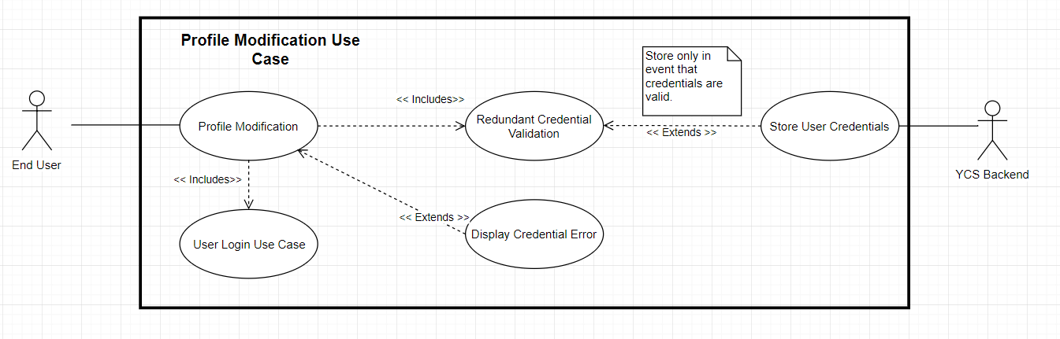
Modify User Profile

Slide 5
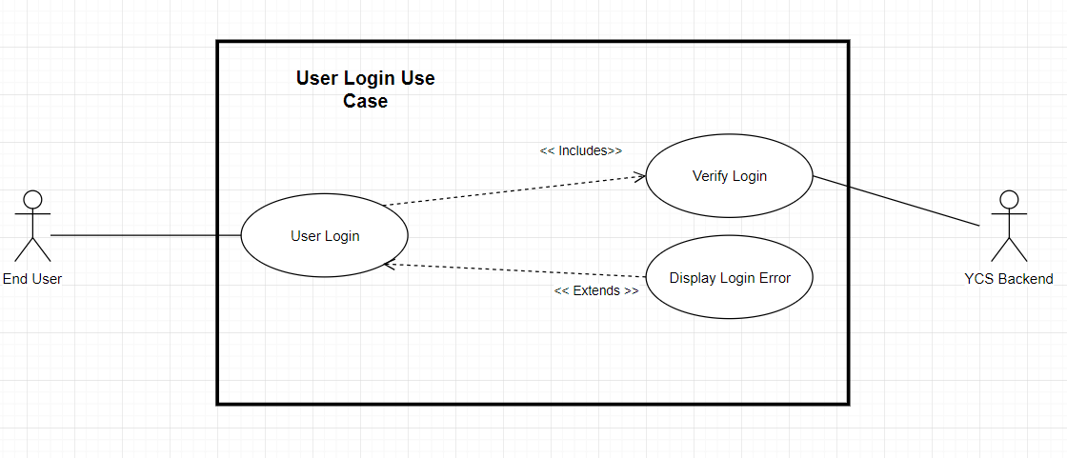
Log-in

Slide 6
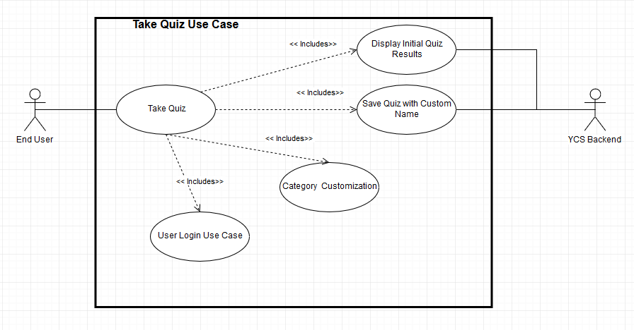
Take Quiz

Slide 7
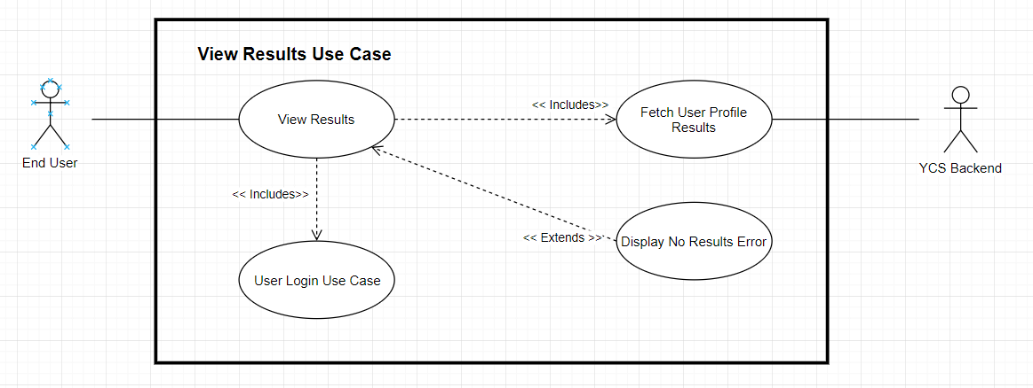
View Results

Slide 8
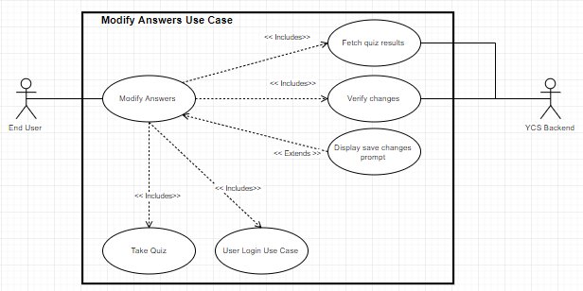
Modify Answers

Slide 9
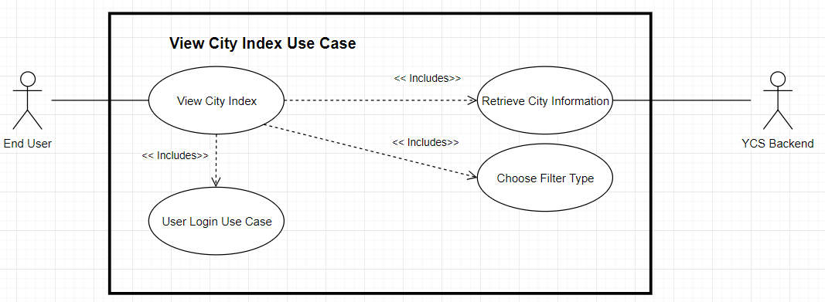
View City Index

